Slide 1

Presentation By: Jose Rivas, Deep Raithatha, Jash Pandya

Slide 2
Program Overview:
D
2-D flight game created with Box2D physics engine, creating earth-like physics aspects. The goal of the game is to collect most points(fish) while trying to collect fuel and not run out. Powerups can increase fuel, and the super power-up being the rocket mode,creating rocket like acceleration. An enemy bird will instantly kill the penguin if they collide.

Slide 3
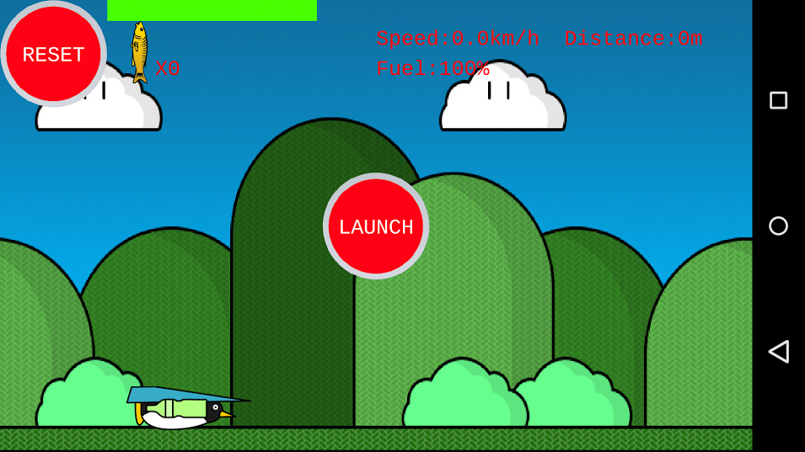
App Screen:
Fuel Bar/Gauge
D
Score count:

Slide 4
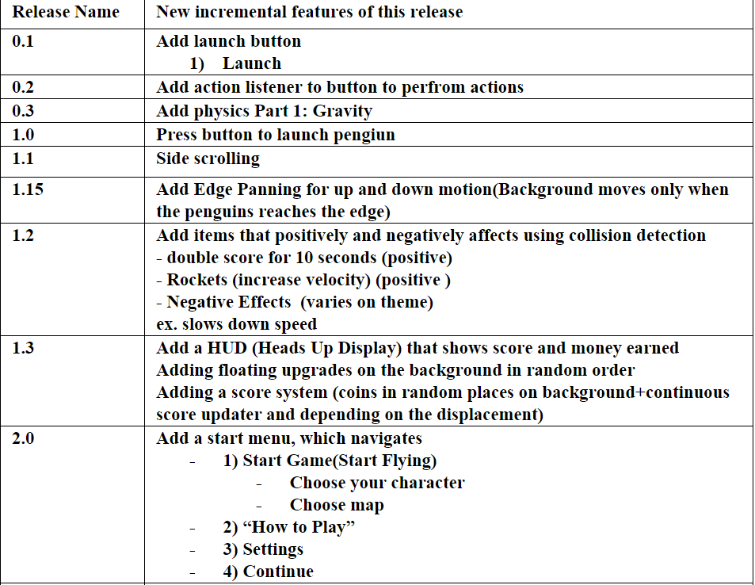
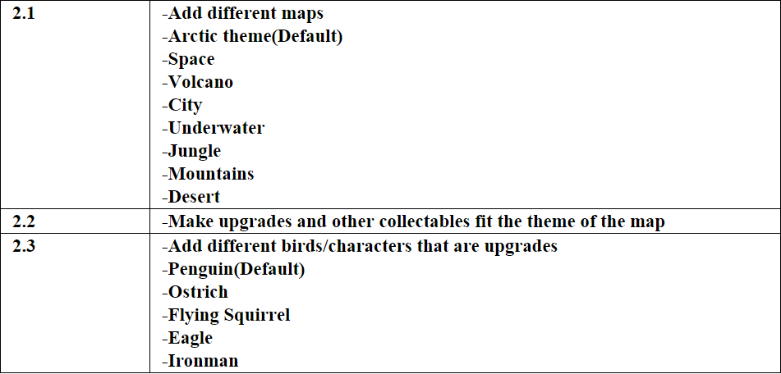
Initial Specifications
Jash
Notes:
Only up to the red line and

Slide 5
List of known bugs:
JDJ
Penguin floats in midair if you tilt too much at the start
Entities spawn in the ground sometimes
Sometimes the fish counter goes up by 2 instead of 1 and sometimes the fuel goes up by double the usual amount. This has to do with how the contact listener detects collision
Rocket power up goes too fast that you will probably die for going above or hitting the ground

Slide 6
In-Game Play
Deep
Since the game requires an accelerometer, the game simulation was recorded.

Slide 7
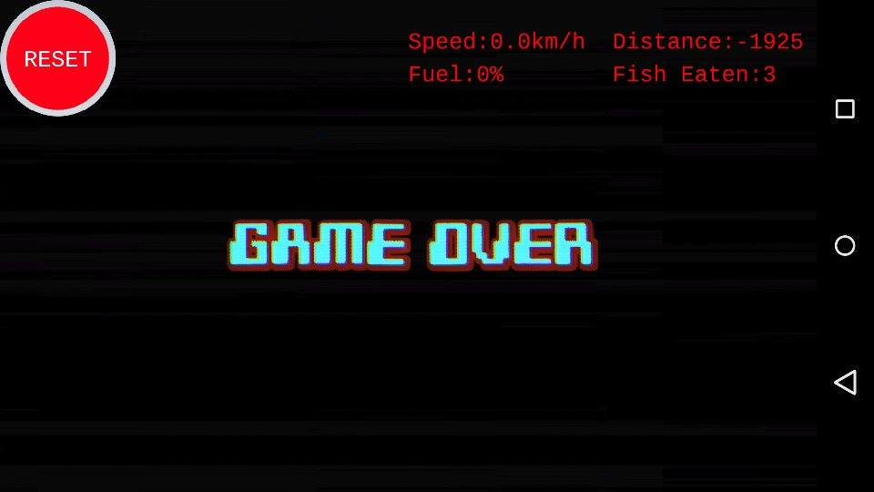


Slide 8
Object Overview
Jash
GameScreen
Ground
Penguin
Entity
Accelerometer
Body
Sprite
Body
Sprite
Body
Button
TextButton

Slide 9
Input
Deep
Touch Input
button.addListener(new InputListener() {//listener for button
@Override
public boolean touchDown(InputEvent event, float x, float y, int pointer, int button) {
public void touchUp(InputEvent event, float x, float y, int pointer, int button) {
2) Accelerometer (separate class)
public class Accelerometer {
public static float accelY(){
return Gdx.input.getAccelerometerY();

Slide 10
Rendering
Jose
nWidth = Gdx.graphics.getWidth();
nHeight = Gdx.graphics.getHeight();
render(){
batch.begin();
batch.draw(spBg, camera.position.x - camera.viewportWidth / 2,
ground.body.getPosition().y, nWidth, nHeight);
penguin.draw(batch);//
entity.draw(batch);
batch.end();
Sprite
X Position
Y Position
Size:X,Y

Slide 11
Orthographic Camera
Jose
OrthographicCamera camera = new OrthographicCamera(nWidth, nHeight);
camera.position.x = penguin.sprite.getX() + penguin.sprite.getWidth()*2;//set the camera position to follow the penguin's position
camera.update();//update once all changes are made
batch.setProjectionMatrix(camera.combined);//This sets the batch to what the camera sees

Slide 12
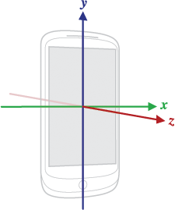
Implementing of Accelerometer
Jash
body.setAngularVelocity(-Accelerometer.accelY() / 3);
//set the angular velocity of penguin to the accelerometer value
Gdx.input.getAccelerometerY();
This method returns a value between -10 and 10 the value is
gravitational acceleration (on earth). -10 and 10 means that
the phone is 90 degrees rotated either to the left or right.

Slide 13
SideScrolling
D
iBg.setWrap(Texture.TextureWrap.Repeat, Texture.TextureWrap.Repeat);
spBg = new Sprite(iBg);
scrollTimer += penguin.body.getLinearVelocity().x / (1070);
if (scrollTimer > 1.0f) {
scrollTimer = 0.0f;
}
spBg.setU(scrollTimer);
spBg.setU2((scrollTimer + 1));

Slide 14

Physics Engine (Box2D)
Jose
Uses Newtons, Meters, Kg, Seconds
world = new World(new Vector2(0f, -9.8f), true);//9.8 m/s² down is real world gravity
Convert Pixels to meters for 100px = 1m
bodyDef.type = BodyDef.BodyType.DynamicBody;//Movement and Collision
bodyDef.position.set(x,y);
body = world.createBody(bodyDef);
shape = new PolygonShape();
shape.setAsBox(sprite.getWidth() / 2 / 100f, sprite.getHeight()/ 2 / 100f)
FixtureDef fixtureDef = new FixtureDef();//Fixture def defines how the body acts on other box2d bodies
body.createFixture(fixtureDef).setUserData("penguin");

Slide 15

Penguin Body & Sprite
Jose
Body
Sprite
sprite.setPosition(x,y);
BodyDef
BodyDef.BodyType.DynamicBody;
bodyDef.position.set(x,y)
Fixture
UserData
Fixture.setUserData("penguin");
*100
px/m
Texture
penguin.png
(x,y)
FixtureDef
fixtureDef.density = 10.0f;
fixtureDef.friction = 0.3f;
fixtureDef.restitution =0.5f;
/100
px/m
Shape
Type
Position(x,y)

Slide 16
Useful Prefabricated Box2D Methods
Jose
body.body.setAngularVelocity(v);
body.setLinearVelocity(x,y);
body.applyForceToCenter(x, y, true);
body.setTransform(x,y,a);
world.step(1 / 60f, 6, 2);

Slide 17
Contact Listeners
Jose
public void preSolve(Contact contact, Manifold oldManifold) {
WorldManifold manifold = contact.getWorldManifold();
Fixture fa = contact.getFixtureA();
Fixture fb = contact.getFixtureB();
for (int j = 0; j < manifold.getNumberOfContactPoints(); j++) {
if ((fa.getUserData() != null && fa.getUserData().equals("penguin")) && (fb.getUserData() != null && fb.getUserData().equals("powerup"))) {
contact.setEnabled(false);
entity.renew = true;//Method in Entity Class Initializes:Using Boolean because it crashes when it just runs the method from here
penguin.dFuel+=10;
}

Slide 18
Frustrations
JD
Box2D- Very confusing to learn but once we learned it it did so much for us behind the scenes
So much time spent getting everyone set up and update the sdk tools,android studio, gradle and github.
Program crashed for no reason(eg. missing button.png but it was right there)Solution:Clean the program first
Slow computer and even computers that stopped working

Slide 19
Our next steps:
All
Two options for input:
Accelerometer
Buttons
2) Title Screen(under progress)
3) FileIO - highscore, resume game and etc.

Slide 20
Notes to Future Programmers
Jash
Keep everything up to date(Git, Android Studio,Gradle)
Create Separate files from the start
Use darcula theme because it looks cool

Slide 21
Sources:
Physics:
http://gamedevelopment.tutsplus.com/tutorials/how-to-create-a-custom-2d-physics-engine-the-basics-and-impulse-resolution--gamedev-6331
https://github.com/libgdx/libgdx/wiki/Box2d
https://www.youtube.com/watch?v=IDZMRDb1A_M#t=812 Unit Conversion
Collision:
http://programmersweb.blogspot.ca/2012/07/simple-libgdx-box2d-bouncing-ball.html
Sidescrolling
http://truongtx.me/2013/04/28/scrolling-background-for-2d-game/
http://www.youtube.com/watch?v=qyRHKkkSa9s
http://novumbit.com/test-how-to/basic-side-scrolling-implementation-in-libgdx/
4) Buttons
https://github.com/libgdx/libgdx/wiki/Texture-packer
n-libgd
5) Flying like Jetack JoyRide and flappy bird
http://stackoverflow.com/questions/22442495/smooth-fly-movement-like-flappy-bird-or-jet-pack-joy-ride-with-gravity-and-accel

Slide 22
Thanks for watching!

